Slide 1

#withk5youcan
K5 Live – Introduction to K5 PaaS, CloudFoundry
Cloud Native & Emerging Technologies (CNETs)

Slide 2
Module Agenda
Purpose
Overview of Cloud Foundry
Topics
What is PaaS?
CF Scaling
CF Routing – Blue/Green Always-on Deployments
CF User Provisioned Services
Labs
PhaserQuest

Slide 3


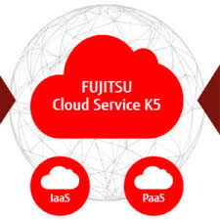






What is PaaS?
“Platform as a service (PaaS) or application platform as a service (aPaaS) is a category of cloud computing services that provides a platform allowing customers to develop, run, and manage applications without the complexity of building and maintaining the infrastructure typically associated with developing and launching an app.” - wiki

Slide 4
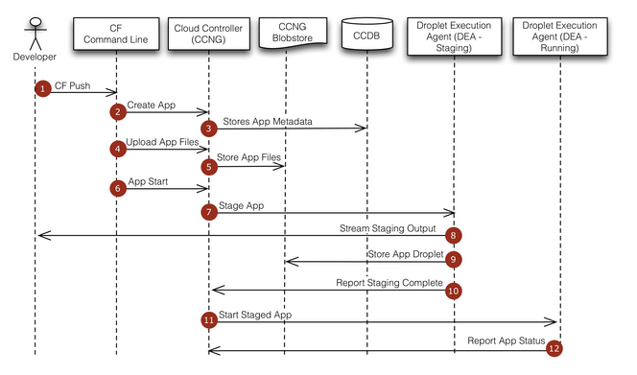
CF Application Deployment Workflow

Slide 5
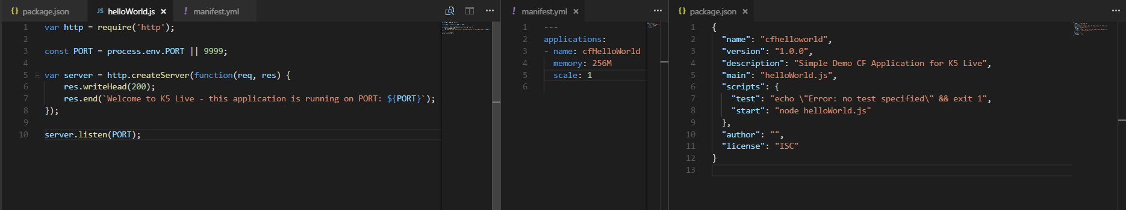
Deploy a simple CF Application
Install the Cloud Foundry Client
https://docs.cloudfoundry.org/cf-cli/install-go-cli.html
Verify account details –
cf login -a https://api.de-1.paas-cf.cloud.global.fujitsu.com -u k5live-(0-24)-user1@ejejvawb -p mypassword -s K5Live-(0-24)
Write Application.js, Package.json & Manifest.yml
cf push

Slide 6
Scaling a CF Application – Horizontal & Vertical
NAME:
scale - Change or view the instance count, disk space limit, and memory limit for an app
USAGE:
C:\Program Files\Cloud Foundry\cf.exe scale APP_NAME [-i INSTANCES] [-k DISK] [-m MEMORY] [-f]
OPTIONS:
-f Force restart of app without prompt
-i Number of instances
-k Disk limit (e.g. 256M, 1024M, 1G)
-m Memory limit (e.g. 256M, 1024M, 1G)

Slide 7
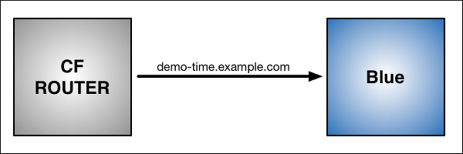
CF Application Routing (Blue/Green Deployment)
cf push Blue -n demo-time

Slide 8
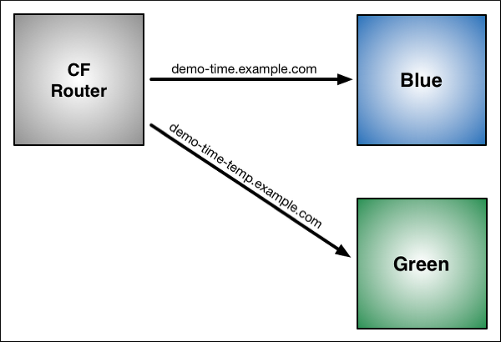
CF Blue Green Deployment Demo
Modify the application then -
cf push Green -n demo-time-temp

Slide 9
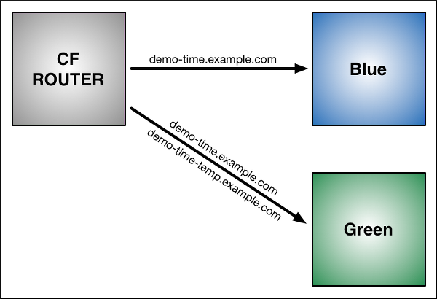
CF Blue Green Deployment Demo
Map Original Route to Green
cf map-route Green uk-1.cf-app.net -n demo-time

Slide 10
CF Blue Green Deployment Demo
Map Original Route to Green
cf map-route Green uk-1.cf-app.net -n demo-time

Slide 11
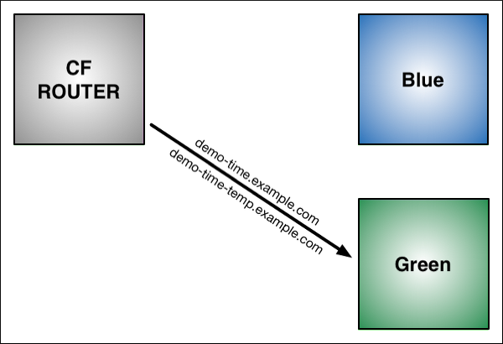
CF Blue Green Deployment Demo
Remove Original Route to Blue
cf unmap-route Blue uk-1.cf-app.net -n demo-time

Slide 12
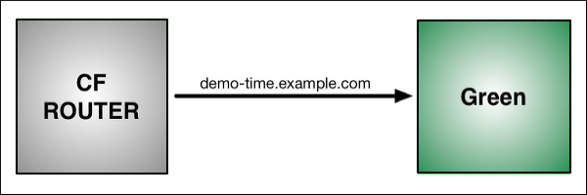
CF Blue Green Deployment Demo
Remove Temporary Route to Green
cf unmap-route Green uk-1.cf-app.net -n demo-time-temp
cf delete-route uk-1.cf-app.net -n demo-time-temp

Slide 13
cf create-user-provided-service (advanced labs)
NAME:
create-user-provided-service - Make a user-provided service instance available to CF apps
USAGE:
cf create-user-provided-service SERVICE_INSTANCE [-p CREDENTIALS] [-l SYSLOG_DRAIN_URL] [-r ROUTE_SERVI
CE_URL]
ALIAS:
cups
OPTIONS:
-l URL to which logs for bound applications will be streamed
-p Credentials, provided inline or in a file, to be exposed in the VCAP_SERVICES environment variable for bound applications
-r URL to which requests for bound routes will be forwarded. Scheme for this URL must be https
SEE ALSO:
bind-service, services

Slide 15
Cloud Foundry (CF) vs Kubernetes (K8s)
Kubernetes is a sophisticated container management platform.
However, K8s -
does not provide middleware
does not have a click-to-deploy service marketplace
does not deploy source code and does not build your application
Kubo: BOSH-Powered, Web-Scale Release Engineering for Kubernetes

Slide 16
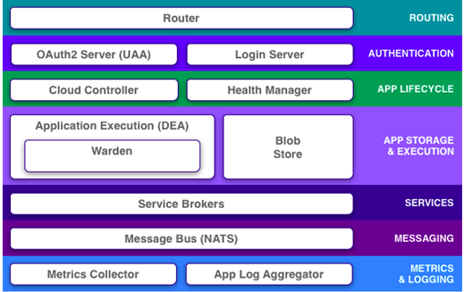
Cloud Foundry Architecture (pre Diego)

